Slide 1

Presentation Outline
03/02/22
Matching Investors to Startups
via an NLP Algorithm
Incentive
Model Core: Multi-label Classification vs Text Vectorisation
Text Mining: Startups & Investors
Results Demonstration
Performance
Product Design
Future Prospects
by Yaniv Amir, PhD MBA
Notes:
Slide 1: Presentation Outline
• What’s the incentive for this work
• Options of the Model Core: whether to use Multi-Label classification or Text Vectorisation
• How to mine text as input for the model for both startups and investors
• I’ll give both a higher level view of the model results and some examples
• I’ll briefly discuss the model’s performance
• and then we’ll go into model design
• and finally what needs to be done next

Slide 2
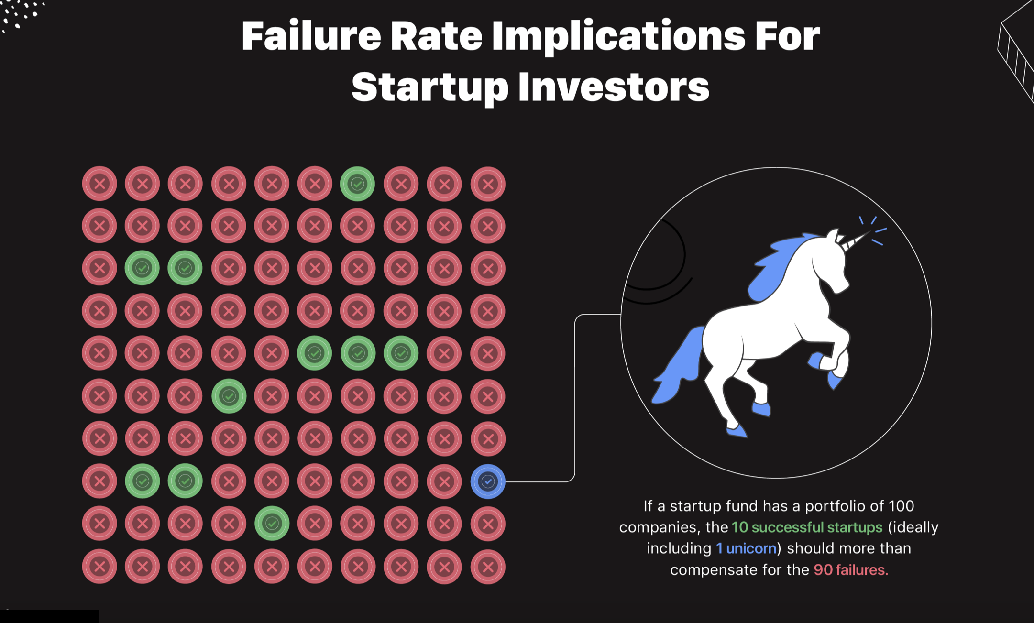

Why do startups fail?
Notes:
Key factors that contribute to at the high chances of startup failure in its first few years are a poor understanding of the market as well as the lack of understanding of consumer behaviors and their needs. From a private investor’s perspective a one-in-ten success ratio could be precarious as most angel investors do not invest in over ten companies. In addition, a mean success ratio of one-in-ten, doesn’t suggest an even distribution: an angel could invest in a single startup and it would turn into a unicorn, or alternatively invest in twenty consecutive failures…
The premise for this project is that both angel investors, as well as the startups they invest in, will benefit greatly from an optimal fit between the angel and the startup, leveraging the angel’s unique set of experiences and skillset in a specific market, as well as their network, in order to drive and support the startup in its early days.

Slide 3
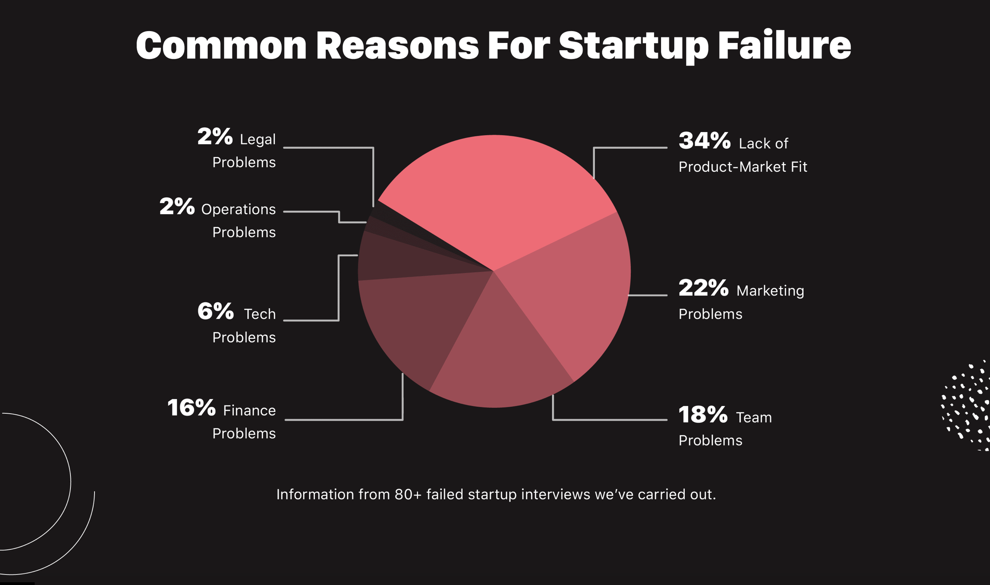
Investors can bridge the knowledge gap
Providing valuable market know-how & connections
Notes:
Slide 3: Reason for Startup Failure
• So once again, without going into to much detail as to the specific study and its validity..
• Still studies agree that a major contributor to the failure rate of early startups is a true understanding of the specific market, the product fit and the costumers needs and desires.
• So the major question this model is intended to address is:
• Can Investors, who have a strong stake in a startups success, draw on their previous experience in the specific market-niche and hard-earned skill-sets to provide much-needed nurturing in the form of guidance, connections, etc to help these early startups survive and flourish.

Slide 4
Brief
Match Startups and Investors based on shared market niches and technology
Challenges
Text Mining: Find a simple and uniform method to describe the startups, their market and competitive edge.
Text vectorization and comparison between startups to find similarities
Find optimal startup-investor combinations
Notes:
The Brief:
Given a list of 200 startups and 200 angel investors, detailing their professional experience and investment portfolio, find optimal investor-startup combinations.
The model was to be later scaled up to contain over a thousand startups and over a thousand investors, including other type of investors such as institutional and hedge funds.
The challenges:
A simple and robust method to mine text describing the startups, their market and technology.
Text vectorization and comparison between companies to find similarities
Using the text mined, and vectorization method to find optimal startup-investor combinations
Solution:
What is a ubiquitous text processing “machine” who’s main goal is to provide the most concise and market-relevant information about each entity? Google it.
Google’s search engine has been perfected using decades of evolution, aided by outrageous sums of monetary investments, to provide the most relevant and concise description of a company when you google its name. Concatenating the first few search results’ descriptions provides a paragraph containing A LOT of keywords describing the company, its market and competitive edge / unique market perspective.
The format is uniform, the method is robust, the heuristics are simple! Heaven.
One caveat is that Google doesn’t particularly like to accommodate text mining endeavors.. however there are discretion methods that can be used to fly below their radar.
The second challenge:
Now that I have a relatively uniform description of each company, how do I turn the text into a vector for comparing between companies, looking for different degrees of similarities?
Solution:
Term Frequency / Inverse Document Frequency (TF-IDF) method.
The method calculates a product of two ratios:
the first ratio is the Term’s (=word) frequency in the entire corpus of text, I.e. ALL companies.
the second is the logarithmic of the ratio of the number of different texts (=companies) in the corpus divided by the number of companies containing the specific term. So the rarer a word is in the corpus, the higher this value will be.
The result of the product of the two ratios provides a wide differentiation across the different term frequencies which are used to calculate of a particular term is useful in describing a company, as a function of how often it is used to describe the company, compared to how often it is used to describe other companies.
A ubiquitous word will receive a low score. A word which is rare in the company description and exists once in the company’s description (it’s name for example) , will also receive a low score. A word which is relatively rare in the entire corpus but exist multiple times within the specific company’s description will receive a high score.
Not only single words can be used at a “term” but 2-, 3-word combinations can also be used. Alternatively subwords can also be used as “terms”. In this project I was both single-word, multiple-word and character strings of various lengths to describe each text, and to compare between vectors.
Next cosine similarities, based on the angle between each two vectors, can be used to compare different companies and look for similarities, providing a comparable degree of “similarity”.
Finally, The Third Challenge:
How to use the TF-IDF method to look for similarities between startups and investors professional experience?
Solution:
One unbiased testimony to an angel’s professional expertise and unique skill set is their work experience, specifically the companies they worked for, been on the board of, or invested in in the past.
Basically, it’s the same solution as was used for a single startup, i.e. text mining via Google search results and TF-IDT vectorization. The only difference is that each investors is comprised of several vectors, each representing a company in their work experience.
How can we screen the the startups to look for the best investors suitable for combined synergy?
I suggested two options, both work very well, depending on the specific requirement:
Out of all the companies in the investor’s portfolio - look for the one that is most similar to the specific startup screened. The maximal score out of the the portfolio companies is best for diversified investors who have invested in several, very different markets.
Take an average measure of all the individual similarities of companies in the investors portfolio, compared with the specific startup screened. This measurement os best for finding a expert investor, whose entire work experience is best suited for the startup in question.

Slide 5
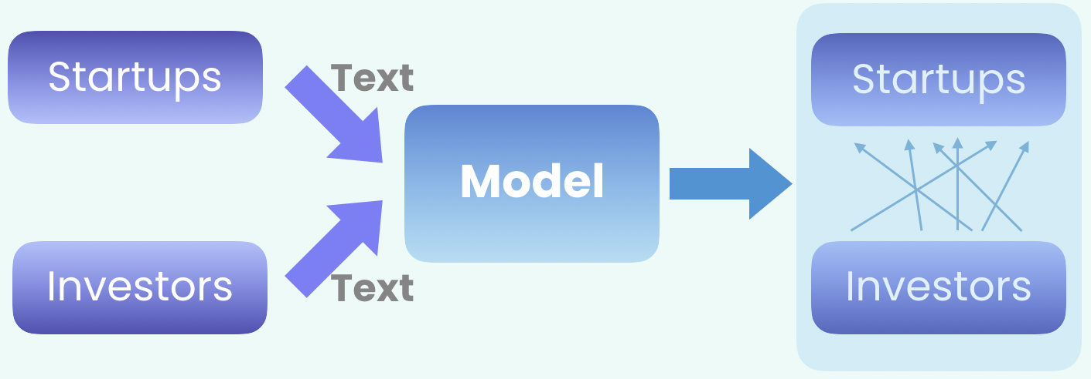
NLP Model Requirements
Quantifiable Results
A Sorted List of Recommended Startups per Investor
Equal Representation for each Startup/Investor
Scalable & Adaptable Model
Input Information about each Investor/Startup to be uniform in scope and depth
Notes:
Slide 5: Model Requirements
• Here is a very high-level view of the model:
• The model takes a textual input of both investors and startups and outputs a recommendation for each investor and startup. And while we are very much interested in the final results, the model itself is of more interest as we want to repeat the calculations in the future, and enlarge the database, to include more investors and more startups.
• So the model requirements are:
◦ That it’ll provide quantifiable, comparable recommendations per investor
◦ So that each investor will receive a list of recommended startups, sorted by their match scores
◦ The model needs to be scalable, and it should give better recommendations as the database grows
◦ The model should provide equal opportunity and representation to each of the startups and investors, regardless of specific market niches or backgrounds
◦ and in order to provide an equal opportunity the input itself should be unbiased. It should be as uniform as possible, across different companies. I will elaborate in a moment.

Slide 6
Multi-Label Classification
Company A
Investor A
Company B
Label 1
Investor B
Company C
Label 2
Investor C
Company D
Label 3
Investor D
Label 4
Investor E
Company E
Label 5
Investor F
Company F
Label 6
Company G
Investor G
Company H
Investor H
Better Suited for larger Datasets, with adequate/minimal representation of each Label
Relies on a pre-determined pattern, rather than data-emergent pattern
Reduces information to a limited set of keywords
Notes:
Slide 6: Model Core: Multi-Label Classification
• The most intuitive model is to use multi-label classification, using market sectors as labels. It is not the final model, However I want to briefly focus on it as it emphasizes the reasons to choosing the final model
• for multi-Label Classification the idea is that a pre-determined list of labels acts as a mediator between Startups and Investors.
• Its intuitive because the human brain does this all the time, it is a very efficient way to deal with highly-complex multi-dimensional data, by reducing it to a single axis: good / bad / better / worst. For example, IQ tests as a measure of intelligence.
• for an NLP model, the problem is:
◦ It needs a large dataset with known labels to train the model for each of the labels. Teaching the model what is a ‘Medical Device’ startup, for example, and what is not.
◦ The sectors are pre-defined by a human. We constrain the model to find similarities based on a pre-notion of a pattern in the data, and it is almost never the most efficient pattern that can emerge for the data unsolicited.
◦ Multi-Label Classifications reduces the information provided by each data entry. Large dataset require this reduction so that their performance will be as fast as possible, in the cost of very valuable information being lost in the process.
◦ In our case, as we have a very small dataset, the reduction of information per data instance is unnecessary and we can use the input text in its entirety to find better matches.
◦ Therefore I chose Text Vectorisation as the model core for this particular analysis.

Slide 7
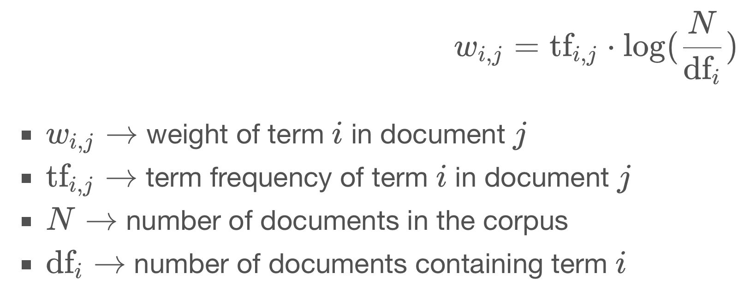
Text Vectorisation via TF-IDF
Term Frequency - Inverse Document Frequency
 |  | Startup Text
 |  | Common Term | Rare Term
Entire Corpus | Common Term | Low Score | Very Low Score
 | Rare Term | Very High Score | High Score
Notes:
The second challenge:
How to turn each startup’s description into a vector for comparing between companies?
Solution:
Term Frequency / Inverse Document Frequency (TF-IDF) method.
The method calculates a product of two ratios:
the first ratio is the Term’s (=word) frequency in the entire corpus of text, I.e. ALL companies.
the second is the logarithmic of the ratio of the number of different texts (=companies) in the corpus divided by the number of companies containing the specific term. So the rarer a word is in the corpus, the higher this value will be.
The result of the product of the two ratios provides a wide differentiation across the different term frequencies which are used to calculate of a particular term is useful in describing a company, as a function of how often it is used to describe the company, compared to how often it is used to describe other companies.
A ubiquitous word will receive a low score. A word which is rare in the company description and exists once in the company’s description (it’s name for example) , will also receive a low score. A word which is relatively rare in the entire corpus but exist multiple times within the specific company’s description will receive a high score.
Not only single words can be used at a “term” but 2-, 3-word combinations can also be used. Alternatively subwords can also be used as “terms”. In this project I was both single-word, multiple-word and character strings of various lengths to describe each text, and to compare between vectors.

Slide 8
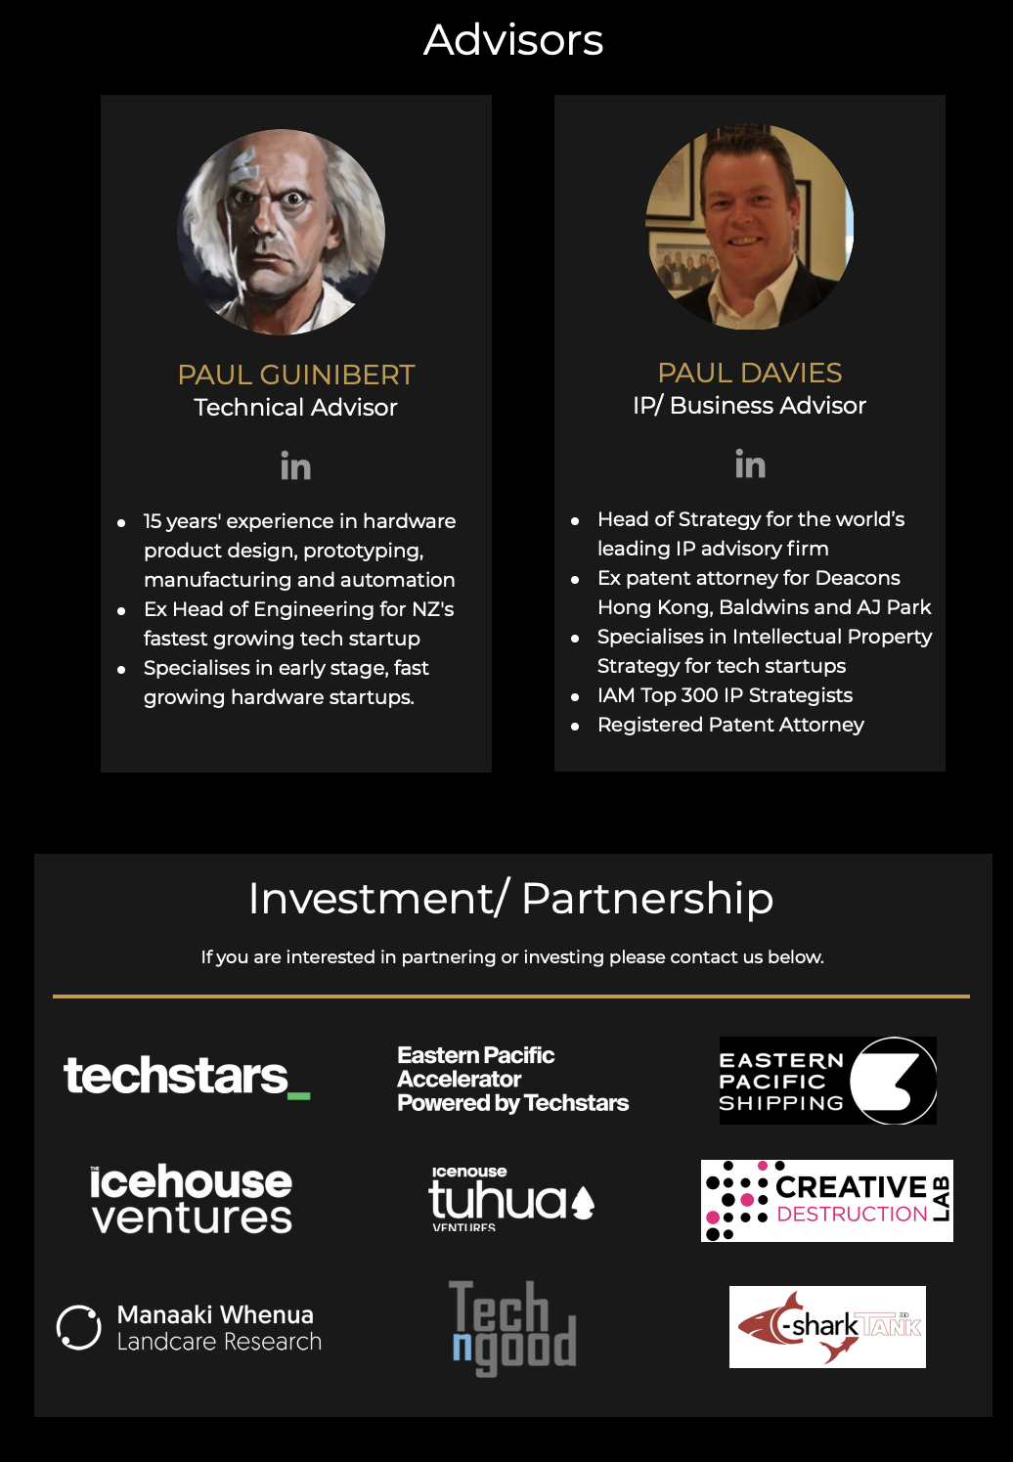
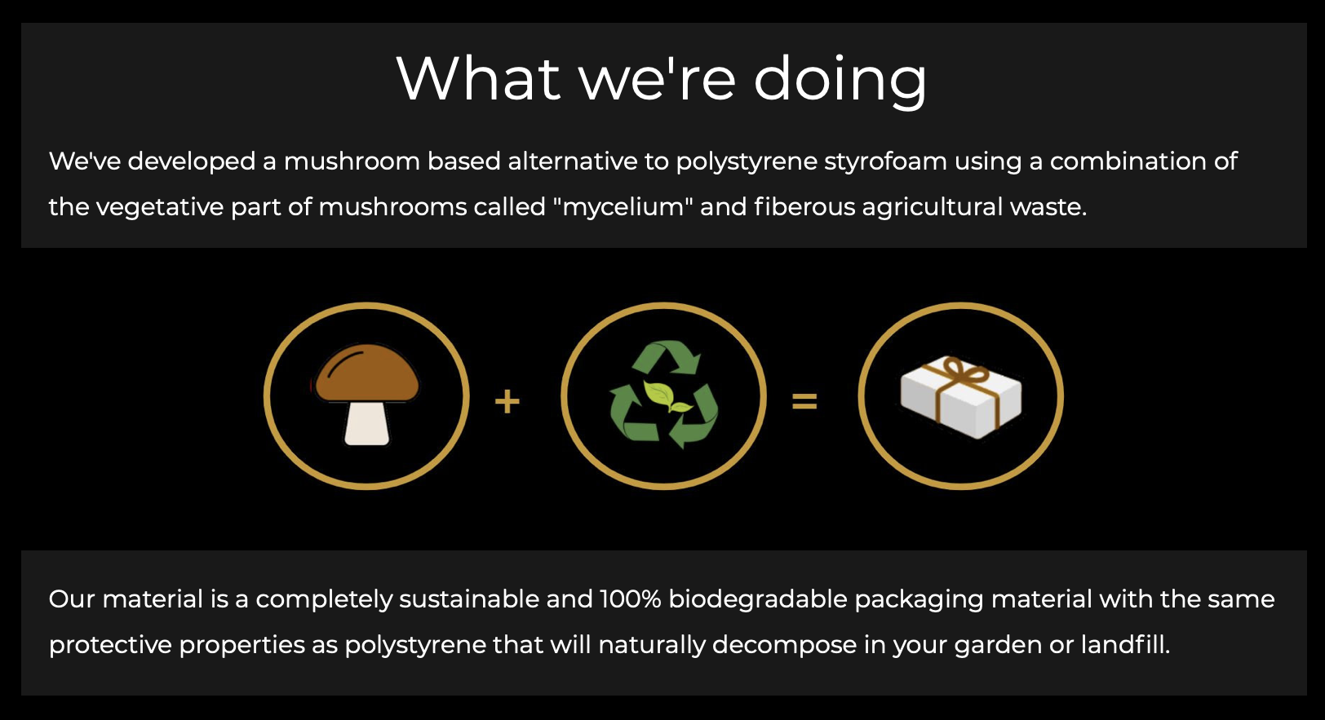
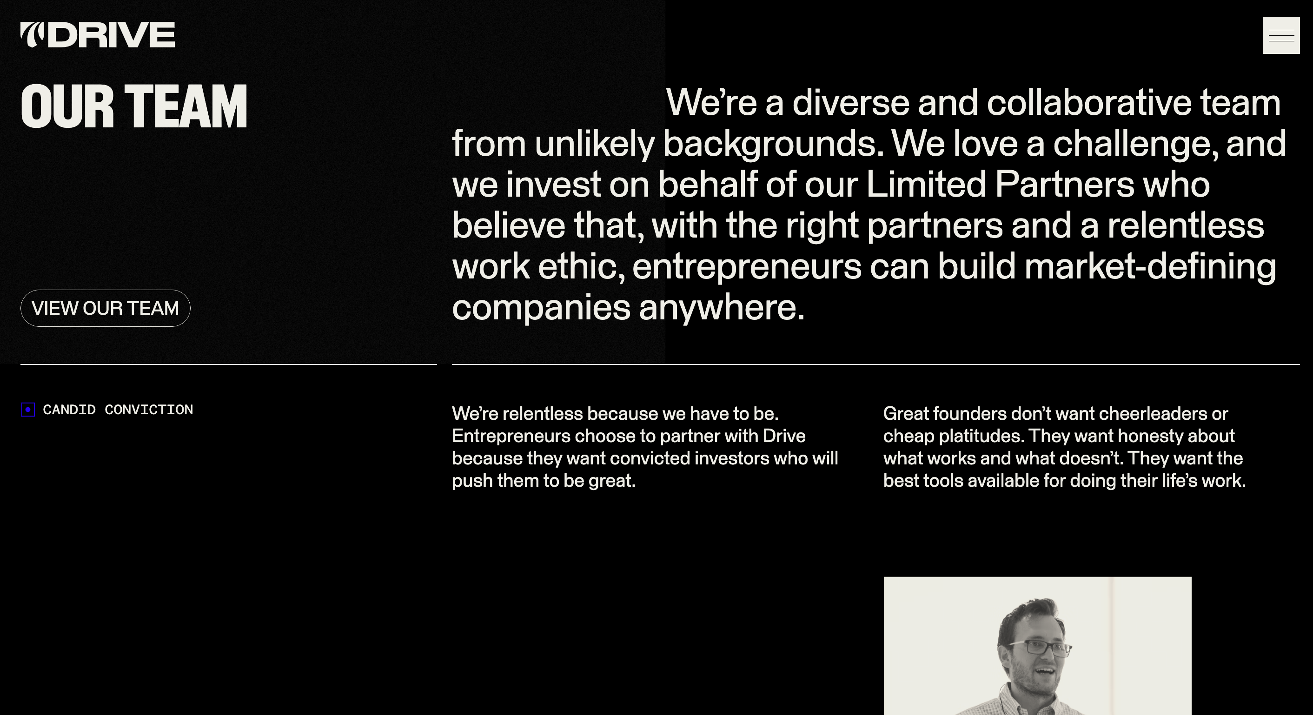


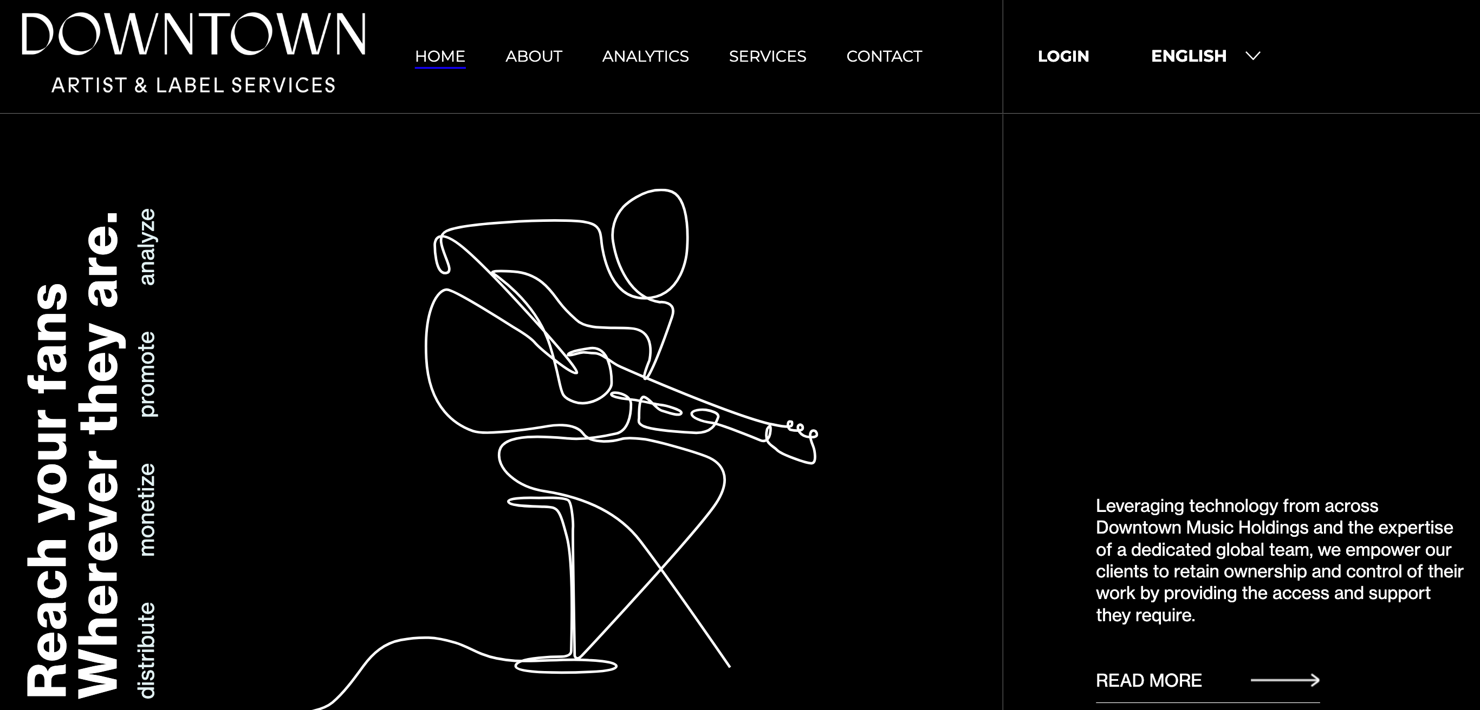
Text Mining: Websites are too chaotic!
Notes:
The first challenge:
How to find a concise and relatively uniform method of describing each startup, their market and products/services as well as their technology and competitive edge, from which a basis for comparison between the startups can be made?
Startup websites are intuitively the source for this type of information. However, looking at a startup’s website, the information provided differs greatly in format from one startup to the next. Some websites prefer text, ranging from a short paragraph to pages and pages of (mostly tedious) information, while others opt for a visual explanation, using images and videos.
From a text mining perspective, this is a BIG problem, as there are no simple heuristics which can be written in code to turn the process into an efficient one. In addition, the description will vary greatly in length and style between companies.

Slide 9
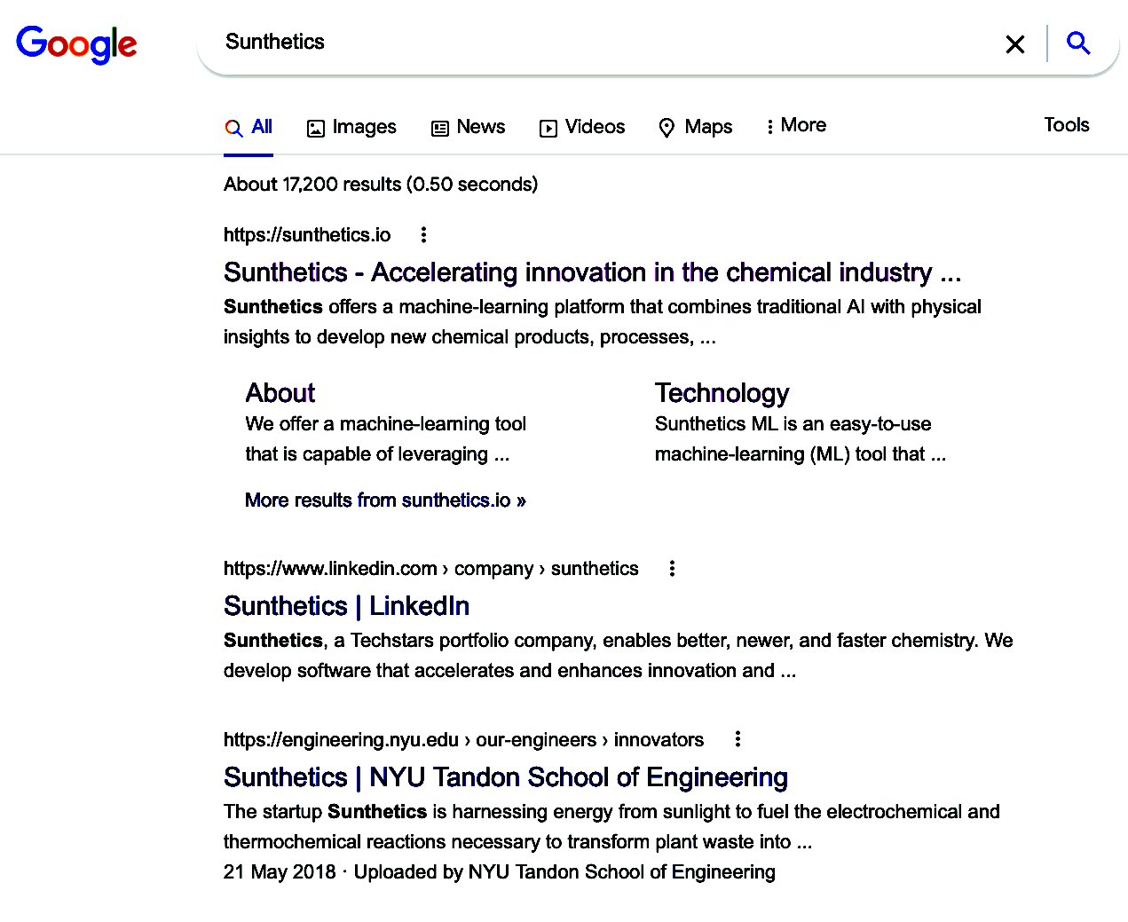
Text Mining: Google Search Results
Notes:
Solution:
What is a ubiquitous text processing “machine” who’s main goal is to provide the most concise and market-relevant information about each startup? Google!
Google’s search engine has been perfected through decades of commercial evolution to provide the most relevant and concise description of a company, all within a few lines of text. By concatenating the first few search results’ descriptions a paragraph is constructed, containing A LOT of keywords describing the company, its market and competitive edge / unique market perspective.
The format is uniform, the heuristics are simple and the method is robust!
One caveat is that Google doesn’t particularly like to accommodate text mining attempts, however there are workarounds that can be used.

Slide 10
Text Mining: Google Search Concatenation
startup harnessing energy from sunlight fuel electrochemical thermochemical reactions necessary transform plant waste into developer firstgeneration smart electrochemical equipment designed sustainable chemical manufacturing companys easytouse hardware machine develops smart electrochemical reactors enable fast hyper efficient sustainable development new chemicals driving change chemical industry one reaction time we develop ml platforms better newer faster chemistry we develop software accelerates enhances innovation machine learning platform combines traditional ai physical insights develop new chemical products processes size member type innovator ny usa social network part basic chemical manufacturing industry developing first generation smart electrochemical equipment supports easytouse electrochemical reactors blanco her cofounder chemical biomolecular engineering miguel modestino their chief technical
Startup A
startup developing selling shortrange radar sensors drones robotics iot applications companys solutions radar sensors from corporation listed on everything rf search specification selected filters manufacturers corporation provides short range radar sensors traffic monitoring drones robotics iot systems our sensors provide motion detection speed products available mouser electronics corporation ghz doppler radar sensor ip enclsoure wifi bluetooth corporation profile listed on everything rf find news products white papers from corporation on everything rf flexible mounting radar sensor traffic monitor applications san jose ca usa august corporation introduces wifi enabled radar sensor cloud connectivity February corporation innovative develops sells short range radar sensors drones robotics iot applications makes quick simple easy employ remote teams anywhere world from onboarding payroll legal compliance we take care all supplier short range radar srr modules providing enhanced information about world around us focused on enhancing omnipresense silicon valley
Startup B

Slide 11
Text Vectorisation via TF-IDF
Example Startup’s Description
startup harnessing energy from sunlight fuel electrochemical thermochemical reactions necessary transform plant waste into developer first generation smart electrochemical equipment designed sustainable chemical manufacturing companys easytouse hardware machine sunthetics develops software electrochemical reactors enable fast hyper efficient sustainable
Example Startup’s Word Scoring
 | startup | software | energy | from | sunlight | fuel | elector-chemical | thermo-chemical | industry | sustainable | hardware
Score | 0.0017 | 0.012 | 0.23 | 0.0001 | 0.054 | 0.1 | 0.27 | 0.14 | 0.006 | 0.19 | 0.022
Notes:
◦ In this example words like ‘startup’ and ‘from’ are words that are extremely frequent in all of the texts of the corpus. Almost every text contains them. They are non-informative words, and thus receive a very low score.
◦ Words like ‘software’ ‘hardware’ ‘industry’ and ‘manufacturing’ contain more information, however they are still very common that indeed most texts contain them.
◦ In contrast, words like ‘energy’ ‘fuel’ ‘electrochemical’ and ‘sustainable’ hold a lot of information regarding the company’s technology. The are common in the text itself, but rare in the entire corpus. They are rare in the corpus, but sill common enough that some of the other companies contain them. These words will contribute greatly when we what to use this vector to look for other, similar vectors in the corpus later on.
◦ if we have a small corpus, such as in this case, we can further expand the vector to include not only single words, but also phrases comprised of several words: such as ‘sustainable fuel’ or ‘manufacturing industry’
◦ and we can even further expand the vectors by breaking down each word to a varying length of characters so that ‘thermochemical’ can become ‘thermo’ and ‘chemical’ among other variations, this can potentially increase the likelihood of finding similarity among different vectors.

Slide 12
Sanity Check: Text Mining + Vecotrisation
Startup A Description
Applies deep learning to speech processing providing voice cloning for content creators in movie studios and game developers
Similar Companies Scores by Model:
Rank | Most Similar | Second Most Similar | Third | Fourth | Fifth | Sixth
Score | 0.161 | 0.124 | 0.110 | 0.107 | 0.106 | 0.101
Most Similar Company
Second Most Similar Company
Educational AI Voice Speech Recognition, improving English speaking skills uses voice recognition technology to interact with a virtual video tutor and receive instant feedback.
Using AI to analyze subtext, helping salespeople identify and interpret. Helping Inside Sales Close More Deals and bridging the gap between virtual and face-to-face communication.
Notes:
Next cosine similarities, based on the angle between each two vectors, can be used to compare different companies and look for similarities, providing a comparable degree of “similarity”.
Finally, The Third Challenge:
How to use the TF-IDF method to look for similarities between startups and investors professional experience?
Solution:
One unbiased testimony to an angel’s professional expertise and unique skill set is their work experience, specifically the companies they worked for, been on the board of, or invested in in the past.
Basically, it’s the same solution as was used for a single startup, i.e. text mining via Google search results and TF-IDT vectorization. The only difference is that each investors is comprised of several vectors, each representing a company in their work experience.

Slide 13
Sanity Check: Text Mining + Vecotrisation
Startup B Description
Manufacturer of a nano-additive material intended to maintain the integrity of composite materials for industrial use.
Similar Companies Scores by Model:
Rank | Most Similar | Second Most Similar | Third | Fourth | Fifth | Sixth
Score | 0.145 | 0.144 | 0.114 | 0.104 | 0.103 | 0.102
Most Similar Company
Second Most Similar Company
using clean lasers to protects the surface of glass metal and plastics from rust ,ice and fouling, for industrial materials
Harnesses the material structure of fungi to grow protective packaging at any scale, replace any existing packaging with a sustainable mushroom alternative
Notes:
Slide 13: Startup Similarities: Example 1
• I want to show examples that both the text mining script and the NLP model works.
• Here I’m using the startup Respeecher as an example:
◦ Respeecher applies deep learning to speech processing, and uses voice cloning for content creators,
• I’m asking the algorithm to provide the most similar companies out of the entire database.
• In table I’m showing you the top six results sorted top to bottom from left to right according to their cosine similarity score.
• Here I’m showing the texts of the two most similar companies in the corpus, which the algorithm found:
◦ SpeakingPal – which does an education AI voice speech recognition to improve english
◦ and Substrata – which uses AI to analyze subtext in converstation and helps sales representative generate better sales
• As you can see both companies are very similar in terms of technology use, i.e. AI speech analysis and creation

Slide 14
Startup Similarities: Example 3
Ecoplant
Developer of an energy platform to optimise and save energy on critical industrial systems such as compressed air and water systems,
Similar Companies:
Induction Food Systems | MADA Analytics | Cyber Observer | BreezoMeter | Revere | PowerMarket
0.1669 | 0.1268 | 0.1211 | 0.1152 | 0.1151 | 0.1148
Induction Food Systems
MADA Analytics
artificial intelligence to optimise efficiency and reduce uncertainty in renewable power plants
Helps food/beverage manufacturers improve efficiency and expand production with on demand precision heating equipment, electric powered induction heating system intended to improve food production efficiencies.
Notes:
Slide 15 Startup Similarities: Example 3
• and the final example I want to show is of Ecoplant which develops an energy platform to save energy in plants using compressed air and water
• and the most similar companies are:
◦ Induction Food Systems, which improves energy efficiency for food and beverage manufactures
◦ and MADA Analytics, which uses AI to optimize efficiency in renewable power plants
• To summarize there example: Both the text mining part of the algorithm and the text vecotrisation core of the algorithm - work. They provide meaningful texts, and similarities between these texts. Similarities that can be harnessed for matching startups to investors based on specific market niches and technology.

Slide 15
Text Mining: Profiling Companies for Investors
Profiling Companies are companies the investor have worked for or invested in in the past and are used to provide skillsets and knowledge of investors.
From NLP model perspective:
Profiling Companies provide an unbiased window into valuable investor info
Comparing ‘Apples’ to ‘Apples’: The model already knows how to mine Company Text from Google Search and Vectorise it into meaningful data
Notes:
Slide 16: Text Mining: for Investors
• Up to now I only discussed similarities between startup texts. Before I will show the final results of the algorithm, I need to address the mining of investor-related text.
• when I first thought of this problem I had difficulty finding text that describes each investor, a text that was uniform in terms of both length and content.
• And the solution that I chose, and works rather well, was to use the investor CV as a profiling tool. More specifically, use the companies that the investor invested in in the past, or worked for, or both, as a window to their particular know-how and skill sets. I termed these companies – profiling companies.
• From a NLP algorithm perspective this is a very elegant solution
◦ as it is an unbiased window into the investors skills and knowledge base
◦ The algorithm already knows how to mine company text from google search and to compare the texts via the text vectorisation algorithm, and does so quite successfully, so it’ll be in the spirit of comparing ‘apples’ to ‘apples’

Slide 16
Final Results: Max Score Option
Investor 1 | Startup 1 | Startup 2 | Startup 3 | Startup 4 | Startup 5
Profiling Company A | 63 | 53 | 31 | 15 | 12
Profiling Company B | 21 | 94 | 21 | 25 | 88
Profiling Company C | 86 | 67 | 62 | 97 | 52
Take Maximum Score for each Startup
Investor 1 | Startup 1 | Startup 2 | Startup 3 | Startup 4 | Startup 5
Highest Score | 86 | 94 | 62 | 97 | 88
Sort
Investor 1 | Startup 4 | Startup 2 | Startup 5 | Startup 1 | Startup 3
Highest Score | 97 | 94 | 88 | 86 | 62
Notes:
How can we screen the the startups to look for the best investors suitable for combined synergy?
I suggested two options, both work very well, depending on the specific requirement:
Out of all the companies in the investor’s portfolio - look for the one that is most similar to the specific startup screened. The maximal score out of the the portfolio companies is best for diversified investors who have invested in several, very different markets.
Take an average measure of all the individual similarities of companies in the investors portfolio, compared with the specific startup screened. This measurement os best for finding a expert investor, whose entire work experience is best suited for the startup in question.
Slide 19: Final Result: Max Score option
• Lets say we have an investor, who has three profiling companies. So for each of the profiling companies and each of the startup the algorithm produces a score. Lets assume for simplicity the dataset has only 5 startups
• So startup 1 receives a score of 63 for profiling company A, a score of 21 for profiling company B and a score of 86 for profiling company C. and similarly for all startups and profiling companies.
• Now the algorithm chooses the maximum score for each startup, under the notion, that the skill set that best describes the investor from the perspective of the particular startup is the skill set with the highest score.
◦ I also added another option for the aggregation as I will describe in a moment, but in this option the investor receives the highest profiling company’s score, per startup.
• Afterward the scores are sorted and a list of most recommended startups, and their respective scores, is provided to the user.

Slide 17
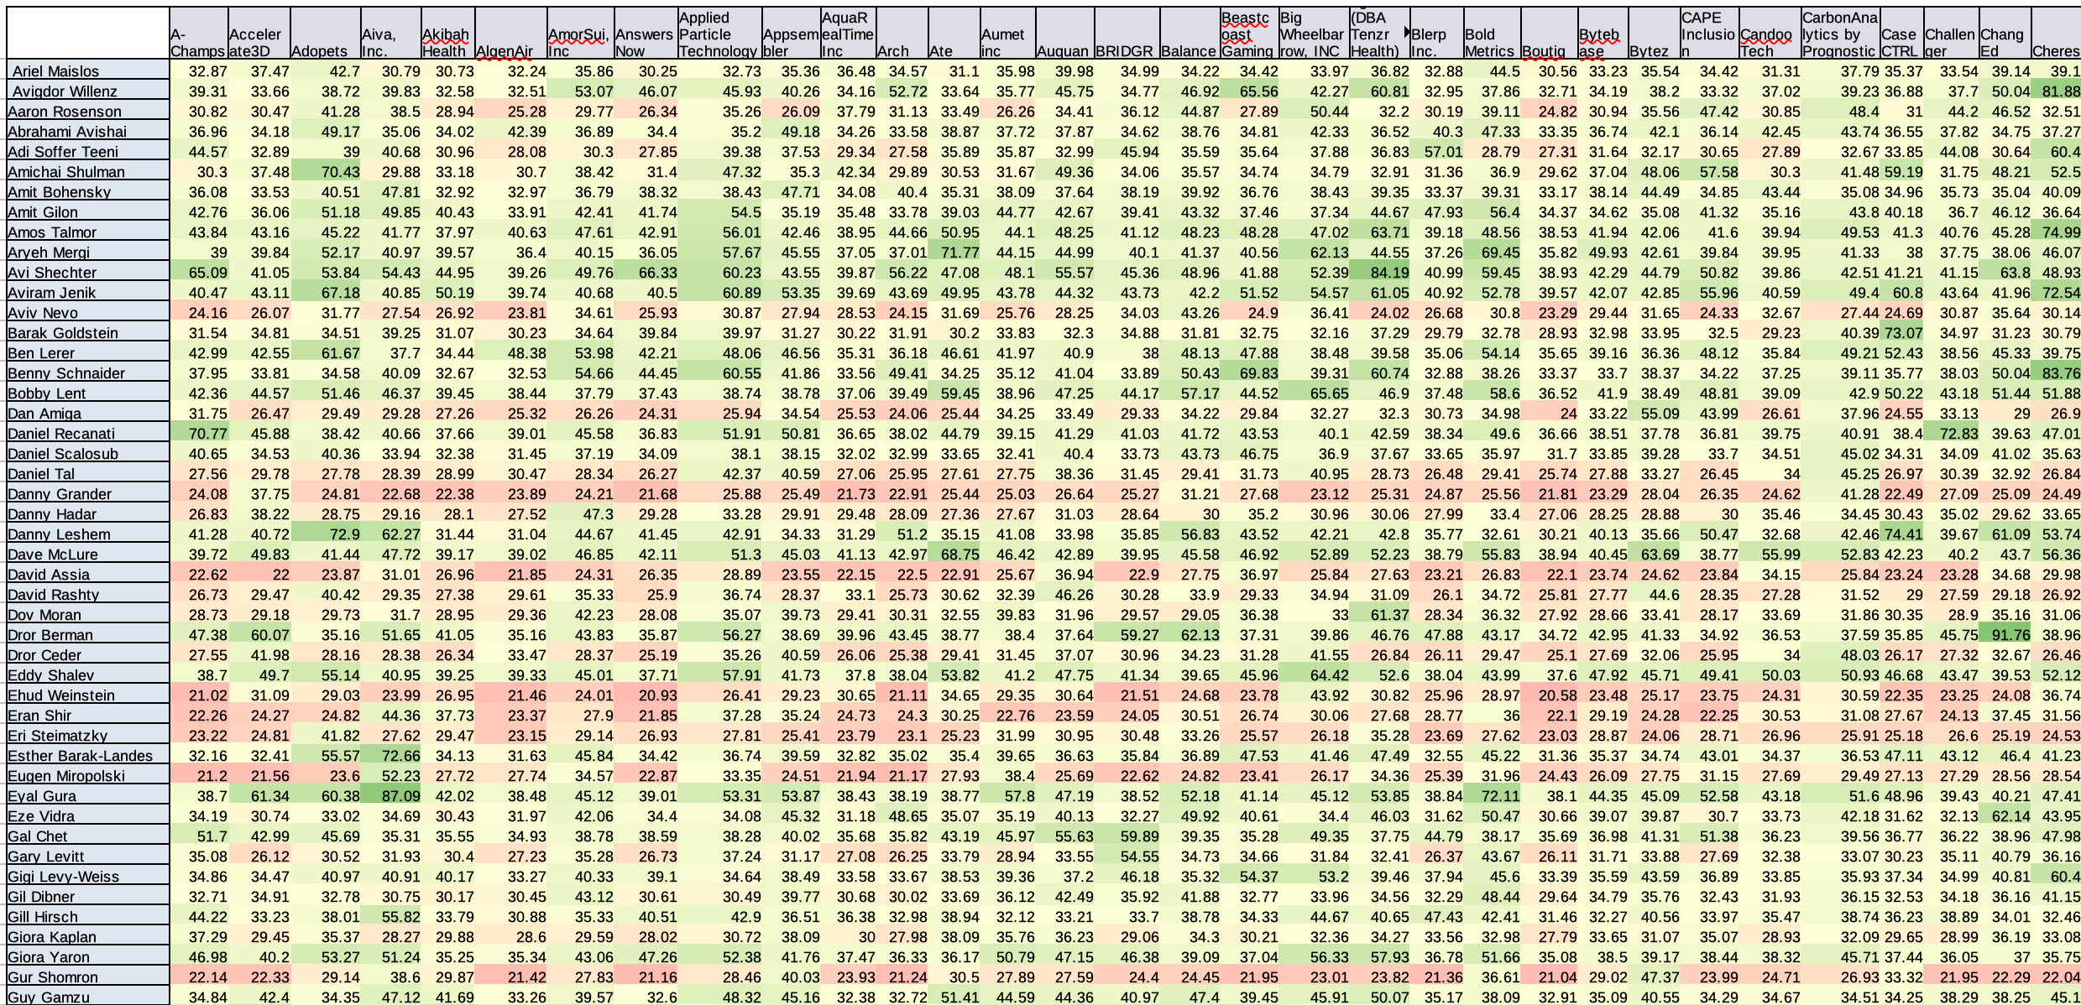
Final Results: Score Matrix
Startups
Investors
Notes:
Slide 18: Final Result: Score Matrix
• Here I’m showing the final result of the model, where the algorithm has scored each investor and startup combination in the dataset, in this particular dataset 180 x 200 combinations. The scoring here is based on the cosine similarity of the text vectors as I showed earlier, it is just normalize to the highest and lowest score to provide a scale of zero to a hundred.
• Notice that each investor/startup combination receives a single score, even though the actual model scores each startup with each of the profiling companies for each investor. I want to go into more detail explaining how the algorithm aggregates the individual scores of each of the profiling companies

Slide 18
Investor 1 Recommendation Example
Profiling Company
Recommended Startups
Company | Description
Profiling 1 | Connects high quality, underrepresented talent, with world-class companies that care about diversity, equity, and inclusion
Company | Description | Score
Startup 1 | A Diversity, Equity, and Inclusion (DEI) SaaS platform to manage and measure DEI initiatives impact | 89.9
Startup 2 | Helps companies attract, recruit Black, Indigenous, and People of Color (BIPOC) talent | 85.6
Notes:
Slide 25: Results Example: Example 2
• Another example, recommendation given to NEOME – Women investment club
• the profiling company that received the highest matching scores was Joonko
• Joonko connects high quality underrepresented talent with talent-seeking companies
◦ Cape Inclusion is a startup that provides a SaaS platform for inclusion of underrepresented talent and measurements of initiatives thereof. The matching received a score of 89.9
◦ and Equipt helps companies attract and retain underrepresented talent. The matching received a score of 85.6

Slide 19
Investor 2 Recommendation Example
Profiling Companies
Recommended Startups
Company | Description
Profiling 1 | An AI lending platform that provides consumer loans using non-traditional variables, such as education and employment
Profiling 2 | Transforming the way companies and governments use satellite imagery data
Company | Description | Score
Startup 1 | A mobile app that helps pay down student loans by using spare change | 91.8
Startup 1 | Revolutionizing student funding by refinancing student loans | 90.2
Startup 1 | Transforms satellite images into useful insights, using AI & ML | 88.7
Notes:
Slide 24: Results Example: Example 1
• I want to demonstrate the results of the algorithm with specific recommendation examples
• For example lets look at the recommendations given to the Angel Dror Berman
• Out of the several profiling companies listed for Dror Berman, Upstart and PLANET received the highest scoring matches
• Upstart is an AI lending platform that provides consumer loans based on education and employment
◦ ChangEd is a mobile app that helps consumer pay off their student loans. This matching receives a 91.8 score
◦ And Defynance help refinance student loans. This matching receives a 90.2 score
• Planet is a profiling company that transforms the way companies and government use satellite imagery data
◦ and Latitude 40 transform satellite images into useful insights using AI. This matching receives a score of 88.7.

Slide 20
Result Examples: Example 3
Investor: Aaron Rosenson
Profiling Companies
Recommended Startups
Company | Description
inDinero | a custom-built cloud-based accounting and tax software service provider
Company | Description | Score
PROFIT | a digital bank for small businesses that provides free banking and bookkeeping | 95.6
Clear | All-in-One SaaS management platform, from discovery to purchasing | 57.7
Notes:
Slide 27: Results Example: Example 4
• Final example, the results for Aaron Resenson
• out of the two profiling companies listed for Aaron, inDinero received the highest two score. Notice that the scores have a wide divergence of 95.6 and 57.7
• inDinero is a cloud-based accounting and tax software service provider
◦ The highest scoring startup to match it was PROFIT which a digital bank providing free banking and bookkeeping. So the high degree of similarity between the profiling company and the startup. Is evident
◦ The second best score was for Clear, a startup that provides an all-in-one SaaS Management platform. While still a management SaaS, it is very removed from the taxing and accounting services provided by inDinero.
• So while PROFIT and inDinero are very similar in their technology and markets, Clear and inDinero are not so similar and the different scores reflects these different in affinities.

Slide 21
Result Examples: Example 4
Investor: Nathan Low
Profiling Companies
Recommended Startups
Company | Description
Praxell | a leading Prepaid Debit Card Program Manager
Imvision | Security Platform provides Computer and Network Security
Company | Description | Score
Kard | Provides banking services for young people, as well as debit cards | 91.1
otto by DEVCON | automated no-code security specialising in risk management and SaaS | 74.4
Notes:
Slide 26: Results Example: Example 3
• Another example, recommendation given to the angel Nathan Low
• The two profiling companies that received the highest matching scores are Praxell and Imvision.
• the matching of Kard startup to Praxell received the highest score of 91.1
◦ Praxell is prepaid debit card program manager
◦ and Kard provides banking services for young people, including debit cards
• the second highest matching was that of otto by DEVCON startup and Imvision, which received a score of 74.4
◦ Imvision is security platform providing computer and network security
◦ and otto is an a no-code automated security specializing in risk management and SaaS

Slide 22
Final Results: Max Score per Startup
Startups
Recommended Investors
Recommended Investors per Startup, listed in score order
Startups
Notes:
Slide 23: Final Result: Max Score per Startups
• we can also reverse the matrix and look at the results from the perspective of the startups, asking which investors is best suited for each startup.
• So here is the list of investors from the top matched to the least. And the respective score on the columns to the right

Slide 23
Final Results: Mean Score Option
Investor 1 | Startup 1 | Startup 2 | Startup 3 | Startup 4 | Startup 5
Profiling Company A | 63 | 53 | 31 | 15 | 12
Profiling Company B | 21 | 94 | 21 | 25 | 88
Profiling Company C | 86 | 67 | 62 | 97 | 52
Take Maximum Score for each Startup
Investor 1 | Startup 1 | Startup 2 | Startup 3 | Startup 4 | Startup 5
Mean Score | 65 | 71 | 38 | 46 | 51
Sort
Investor 1 | Startup 2 | Startup 1 | Startup 5 | Startup 4 | Startup 3
Reorder | 71 | 65 | 51 | 46 | 38
Notes:
Slide 20: Final Result: Mean Score option
• Of course the complementary aggregation option is to look at the entire profiling companies of the investor as a collective and to average the individual scores. The scores will naturally be lower compared with the previous option.
• This option provides a more holistic view of the investors skill set, and recommends the investor whose entire portfolio best matches the startups’ technology and sector.
• In the final product design the user is given the option to choose either aggregating scoring method

Slide 24
Final Results: Max Score Matrix
Notes:
Slide 21: Final Result: Score Matrix
• Now that we understand the scoring in the matrix, we can now sort the results and look at the top recommendation for each investor

Slide 25
Final Results: Max Score per Investor
Notes:
Slide 22: Final Result: Max Score per Investors
• Here is an example of the final results output, where every investors’ profiling companies are listed in the second column, the list of recommended startup is listed in the third column (purple) and the scores of the top recommended startup list in the next columns in a decreasing order

Slide 26
Final Results: Mean Score per Investor
Angels
Best Matches
Notes:
Slide 28: Final Results: Mean Score per Investor – Optional slide
• Here are the recommendations and scoring provided by the second aggregation option, that of averaging the scores for all of the profiling companies to provide the final score for each investor.
• The scores are lower due to the averaging
• these results are not so informative at the moment, but they can be if the companies provided under Profiling Companies will be better suited for this task.

Slide 27


Performance
Text Mining Algorithm
For entire corpus (1000 companies = 180 startups + 210 investors x 4 profiling companies per investor)
~4 hrs. Due to breaks needed for google not to block the algorithm
For a single addition of a company
~0.5 sec
Scoring & Matching Algorithm
For entire corpus (1000 companies)
<30 sec (MacBook Pro i5)
Notes:
Slide 29 Performance
• The text mining part of the algorithm is rather slow and takes about 4 hrs to complete for the entire corpus of 1000 companies (comprised of 180 startups, and 200 investors with an average of 4 profiling companies per investor)
◦ however the long duration is not the result of high computational costs but of the google search engine that requires the script to take random breaks in between mining texts.
◦ However, the mining of the text in bulk, for the entire corpus, has to happen only once. Later on addition of a few companies or a few investors occurs very quickly with an average of about half a second per company text
• The main part of the algorithm, the text vectorization and similarity search has to run from scratch for every addition of investor or company since the algorithm takes every single data in the corpus into consideration for the calculations
◦ luckily this is a very fast protocol that requires about 30 second (Macbook pro i5), to run through the entire corpus.

Slide 28

Product Design
Two Forms: Enter New Data form & Query form
Enter New Data Form
Enter New Startup
Startup Name
Startup Website
Delete Startup
Startup Name
Enter New Investor
Investor Name
Number of Profiling Companies
Company Name
Company Website
Delete Investor
Delete Investor’s Profiling Company
Company Name
Notes:
Slide 30 Product Design
• and finally for the end product and user interface
• It will be made up of two separate forms, one for entering new data and another for query entry
• in the data entry form:
◦ A user can either enter a new startup, in which case the interface requires the name of the startup and the website address.
◦ The user can enter a new investor, in which case the form requires the investor’s name, the number of profiling companies to enter, their name and respective website addresses

Slide 29
Product Design: Enter New Query
Recommendation for Investors / Startups
Show results for All Investors (or Startups) / Single / Pick Several from list
Max Score per Profiling Company/
Mean Score all Profiling Companies
Limit Number of Results / Limit Score of Results
Results
Query with Sorted Results, listing recommendations and respective scores
Additional statistical info table providing context of results
Additional Text Table listing Query’s Text with Results’ Texts
Notes:
Slide 31 Product Design: Enter new query
• In the enter new query form the user has to decide if they want to receive the best matched startups per investor or the best matched investors per startup.
• Then the user decides if they want to run through all investors, or run through only several investors, or just a single investor.
• the user decides if they want to calculate the score based on the mean scores of all profiling companies or use the maximum score out of the individual matches of all profiling companies to each startup.
• The user decides of they wants to limit the number of results or the minimal score of results received
• The results
◦ Will presented in the form of a table, where for each of the queries the matches are listed top to bottom from left to right with their respective scores
◦ An additional table will be provided with the scoring statistics of the entire corpus to provide context of the particular query’s results.
◦ And finally a table listing the texts of the investors’ profiling companies along with the texts of the recommended startups for comparison

Slide 30
Optimise ‘profiling companies’ input
In-depth followup on recommendations provided by algorithm to validate results
Increase investor list to include institutional investors
Higher-level clustering to provide meaningful insights into investors and startups profiling
Future Prospects
Notes:
Slide 31 Future Prospects
• the Profiling Companies entered into the algorithm were not optimize of the task they performed. They are a random assortment of investments from the investors portfolio. It’ll be very beneficial for the success of the algorithm if the profiling companies would represent the skill set and specific know how, connection and market niches the investors are familiar with. These can be prior investments, previous work experience or companies they were a member of their board.
• In-depth downstream followup is required into the recommendations provided by the algorithm so as to validate the results and their potential contribution
◦ For future followup and improvement of the algorithm the user is asked whether the recommendations provided were helpful/valuable on a scaling system. Once enough data be gather it can be fed back to the algorithm in order to improve it
• Investors list is currently limited to Angels. The algorithm allows for adding additional types of investors, including VCs and institutional. The only requirement is that a list of profiling companies be provided for each investor.
• Once enough data is gathered, higher level clustering can be performed to allow for meaningful insights into both startups- and investors- profiles. These could open the possibility to emergent labeling of the data, rather than a pre-determined labeling. However the current space of 180 startups x 200 investors is too limited for any meaningful insight to be extracted.
◦ I attempted several such models for clustering, for example k-means and DBSCAN-OPTICS, but with very limited success.

Slide 31
Thank You!
Yaniv Amir, PhD

